Slide 1
Loyola University Chicago
The university senate and Other shared governance Bodies at LUC
Susan L. Uprichard, PhD
Stritch School of Medicine
Professor of Medicine
Director, Infectious Disease and Immunology Research Institute
Director, Clinical Research Office Biorepository
Outgoing Chair, University Senate
New Faculty Orientation
Fall 2021

Slide 2
Shared Governance at LUC

Slide 3
Elected LUC Shared Governance Bodies
Faculty Council*
University Senate*
University Staff Council*
Student Government
Graduate, Professional, and Adult Council
Graduate Student Advisory Council
* These three bodies will briefly be covered for the purpose of today’s presentation

Slide 4
University Staff Council
A SG body composed of 26 staff employees from LSC, WTC, and HSC elected by their staff colleagues to represent the concerns of and act as a voice for the University staff.
  a forum for communication among staff and between staff and administration
  Provide nominations for staff appointments on administrative committees & task forces
  Loyola Employee Emergency Fund
  Staff recognitions programs
https://www.luc.edu/staffcouncil/index.shtml

Slide 5
University Senate
Mission: To ensuring broad review and discussion of issues, plans, and policies of general University interest
  Membership- 33 Elected faculty, staff, students, and appointed administrators.
  University Provost, Chair of Faculty Council, and Chair of Staff Council also serve ex officio
serves in an advisory capacity to the University President
www.LUC.edu/universitysenate/index.shtml.

Slide 6
Relatively new SG Body formed in 2012 to bring together all the members of the University community
  All past meeting notes are online
  Agenda is posted online prior to each meeting
  Meetings are open to the university community
Represents the University community to the administration and addresses matters of importance to the university community
Governed through Bylaws and a Constitution

Slide 7
University Senate schedule 2021-2022
www.LUC.edu/universitysenate/index.shtml.

Slide 8
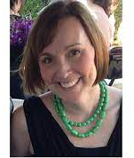
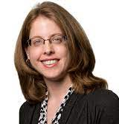
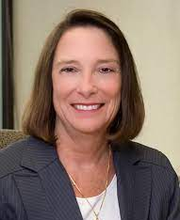
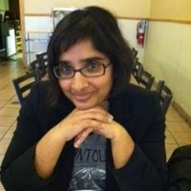

Executive Committee
Sarita Heer, Chair
Erla Dervishi, SGLC VP
Kristin Krueger, Vice Chair
Anne Divita Kopacz, Secretary
Margaret Callahan, Provost
* Open position → Secretary pro tem

Slide 9
Committees
Academic Affairs and Research
Budget and Strategic Planning
Faculty Affairs and Staff Affairs
Student Development and Success
Bylaws and Elections
Diversity

Slide 10
Committees
Reviews, researches, and prepares recommendations on issues and policies related to scholarly research and academic matters in coordination with other academic review bodies at the University
Academic Affairs and Research
Budget and Strategic Planning
Faculty Affairs and Staff Affairs
Student Development and Success
Bylaws and Elections
Diversity

Slide 11
Committees
reviews, researches, and recommendd on issues /policies related to strategic planning, resource allocation, and institutional priorities -- in the interest of promoting transparency and accountability in our planning and budget processes.
Academic Affairs and Research
Budget and Strategic Planning
Faculty Affairs and Staff Affairs
Student Development and Success
Bylaws and Elections
Diversity

Slide 12
Committees
Academic Affairs and Research
Budget and Strategic Planning
Faculty Affairs and Staff Affairs
Student Development and Success
Bylaws and Elections
Diversity
Reviews, researches, and recommends on issues /policies related to the professional development, experience, and contributions of faculty and staff

Slide 13
Committees
Academic Affairs and Research
Budget and Strategic Planning
Faculty Affairs and Staff Affairs
Student Development and Success
Bylaws and Elections
Diversity
Reviews, researches, and recommends on issues/policies that relate to the support of student academic success and student experience.

Slide 14
Committees
Academic Affairs and Research
Budget and Strategic Planning
Faculty Affairs and Staff Affairs
Student Development and Success
Bylaws and Elections
Diversity
Reviews, researches, and recommends on revisions to the University Senate's bylaws and runs the annual election of new members to the University Senate

Slide 15
Committees
Academic Affairs and Research
Budget and Strategic Planning
Faculty Affairs and Staff Affairs
Student Development and Success
Bylaws and Elections
Diversity
reviews, researches, and recommends on issues/policies related to age, race, ethnicity, gender, gender identity, sexual orientation, ability/disability, immigrant/migrant status, origin, and religious affiliation to maintain an affirming, safe and balanced environment for all.

Slide 16
Recent and Ongoing Issues and priorities
Shared Governance Taskforce
  Possible restructuring of the Senate to achieve more equitable representation
Smoke, Tobacco, Vape-Free University
Social & Environmental Justice
  Exploring diversity that encompasses religious practices
  Moving away from fossil fuels
  Moving toward paper-limited classrooms
Benefits (BAC)

